Slide 1
Welcome to BACS (Pty) Ltd
Our Customer Our Future

Slide 2
Company Background
The company was established: 2017
Ownership: 100% black owned with Level 1 BBBEE
Type of Entity: (Pty) Ltd, QSE
Business Owner: Lindisipho Nicholson Batyi (Sipho)
Qualification: ND Mechanical Engineering
Experience: Automotive and Mining Industry
Mobile: 0734231905, email: sipho.batyi@bacs.co.za, website: www.bacs.co.za
Company Registration Number: 2017/248819/07
Value Added Tax Number (VAT): 4200278945
Compliance: ISO9001:2015
Number of employees: 32

Slide 3
Vision, Mission and Values
Vision: provide best value-add-services for customers through innovation and experience.
Mission: to give customers the most compelling value-add-service experience.
Values: integrity, passion, innovation and respect.

Slide 4
Who are we (Team)
Business Owner
QUALITY ASSURANCE
QUALITY INSPECTORS X 3
PRODUCTION
TEAM LEADER X 1
HR/FINANCE
INTELLETO
TECHNICAL SERVICES
EASY DENT
TEAM LEADER X 1
QUALITY INSPECTOR X 3
SPRAY PAINTERS X 3
POLISHERS X 3
SPRAY PAINTERS X 3
POLISHERS X 3
ADMIN
RECEIVING X 6
DISPATCH X 6
JIGGER X 4
JIGGER X 4
Number of employees: 32
Shift pattern: 2 shifts

Slide 5
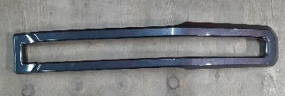
Our Products
Spray Painting of automotive plastic components for the automotive industry (OEMs, after market and Tier One Suppliers) through solvent base process.
Average demand per day is 500 vehicles.
Upper Bar
Centre Bar
Radiator Grill Carrier
Lower Bar

Slide 6
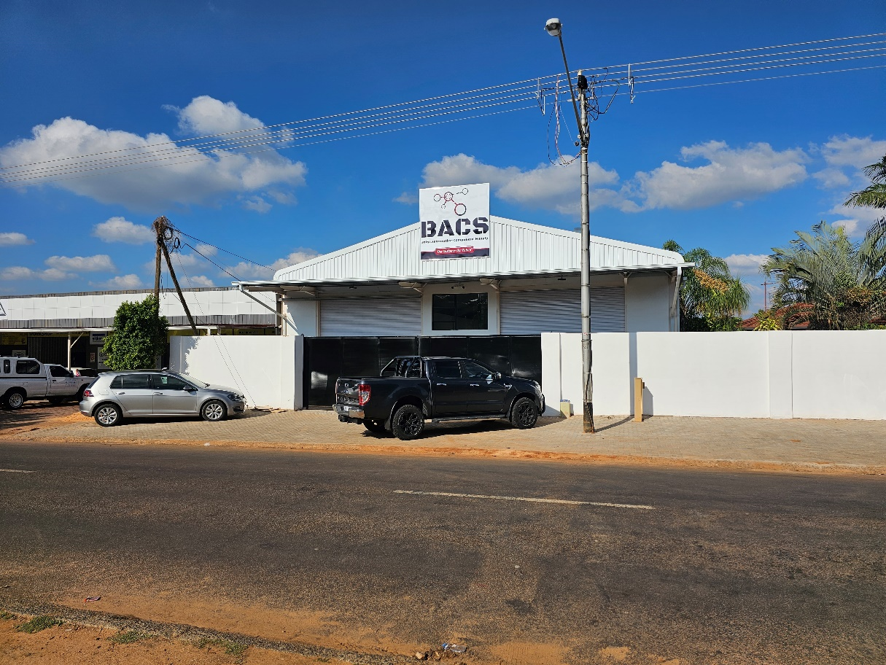
Our Site
Physical Address:
220 Koos De La Rey Street
Pretoria North
Operational area:
800 m2
Personnel:
32 Employees
Site Output:
500 painted parts per day

Slide 7
Key Customers (Target Market)
OEM’s – Gauteng – FMCSA, BMW and Nissan
Tier1’s – Gauteng – MSSL Rosslyn, Automold
OEM’s – Other provinces – VWSA, Toyota and Mercedes Benz
Tier1’s – Other Provinces – MSSL Durban

Slide 8
Current Customers
Current Customers – Easy Dent Remover based in Pretoria North (Supplying MSSL RSA and Ford components).
Annual sales: 120 000 pcs per year.

Slide 9
Short, Mid and Long-Term Strategy
Spray paint interior and exterior trim plastic parts – short term plan.
Injection molding and spray painting of exterior and interior trim – mid-term plan
Steering wheel magnesium die casting – long term plan.
Establish business units by customer products

Slide 10
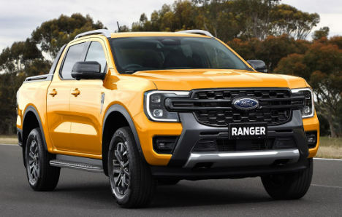
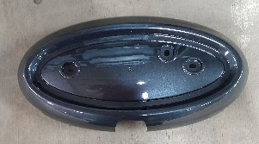
New Programme- Ford Ranger
WILDTREK
Radiator Grill Assembly

Slide 11
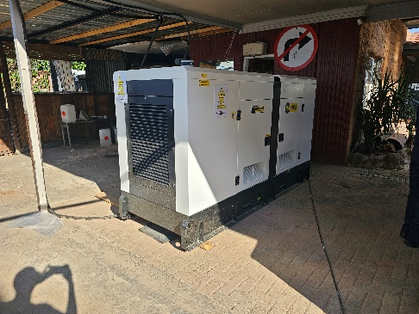
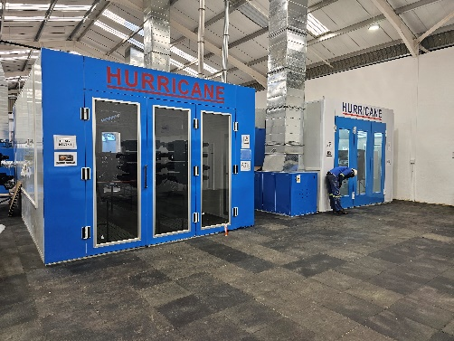
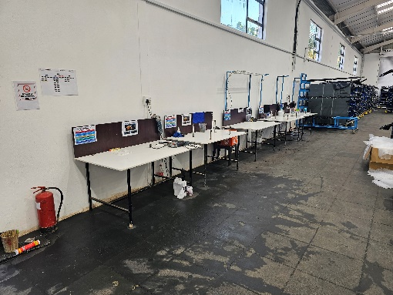
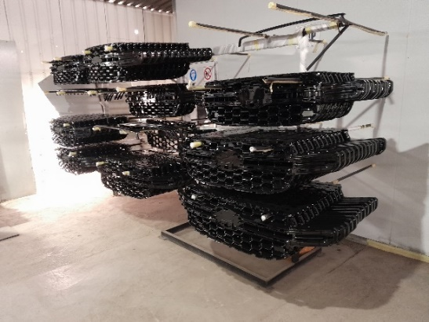
Our Equipment
2 Spray Booths
Backup generator
2 Baking Ovens
Forklift
Polishing Station
WIP Racking

Slide 12
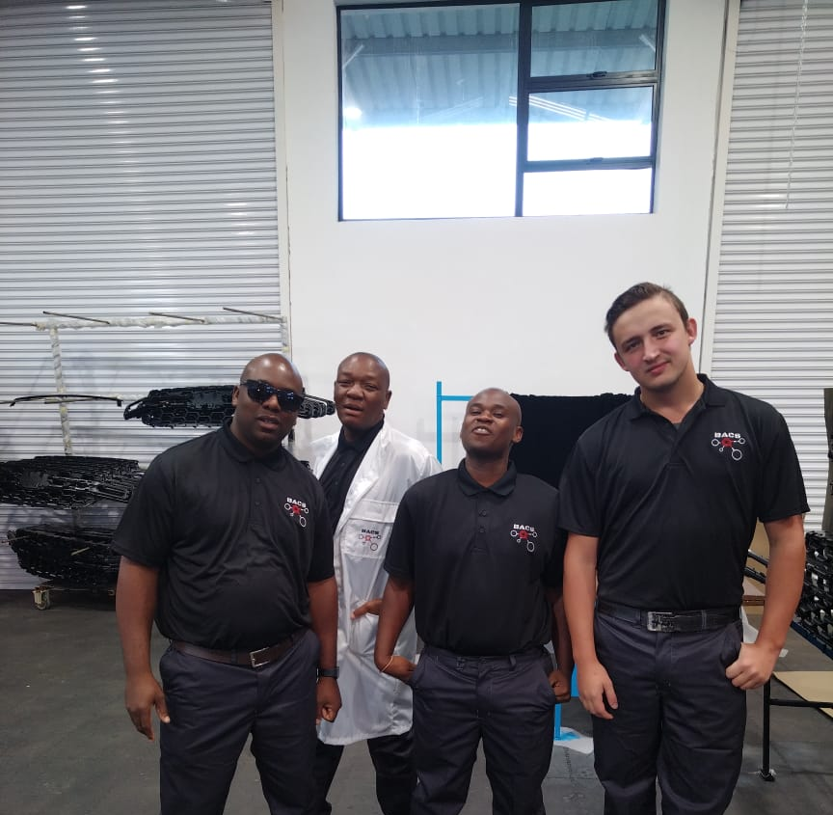
Our Spray Paint Operation
Operation
Spray Painters
Spray paint molded frames Carriers, Lowers, Uppers and Centers.

Slide 13
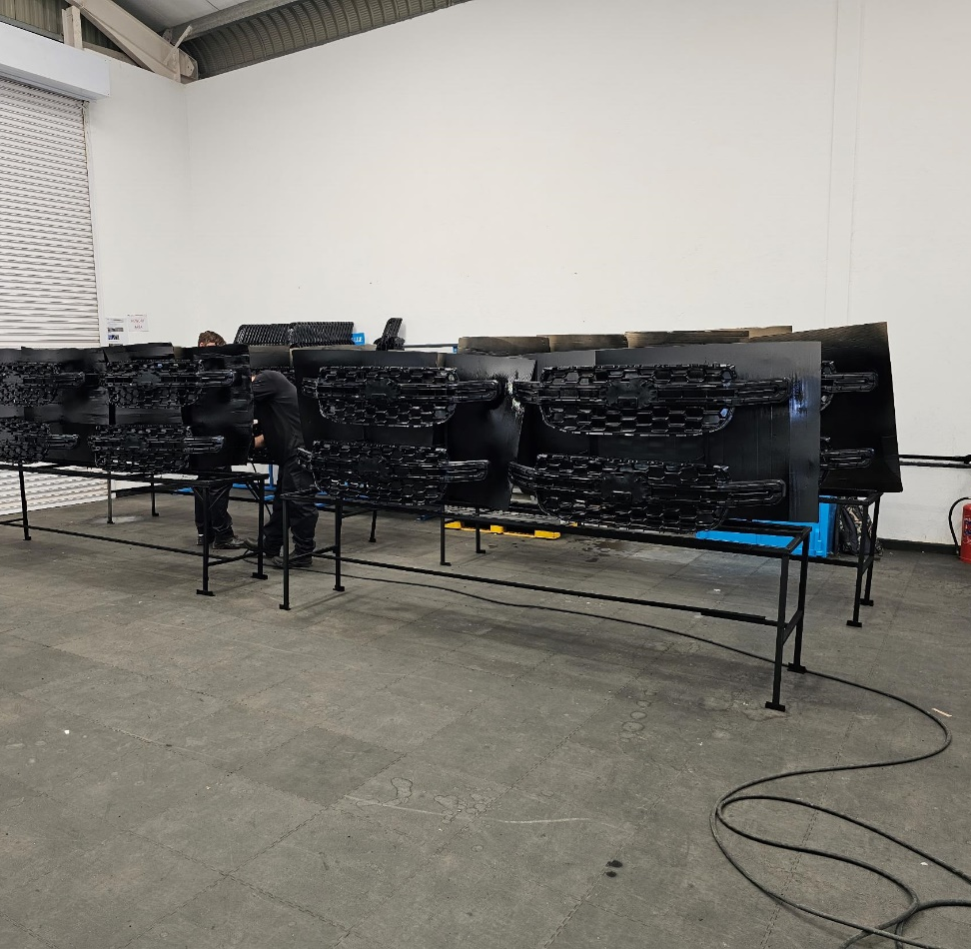
Our Spray Paint Operation
Operation
Paint Jigs
Hold frames in position for spray painting

Slide 14
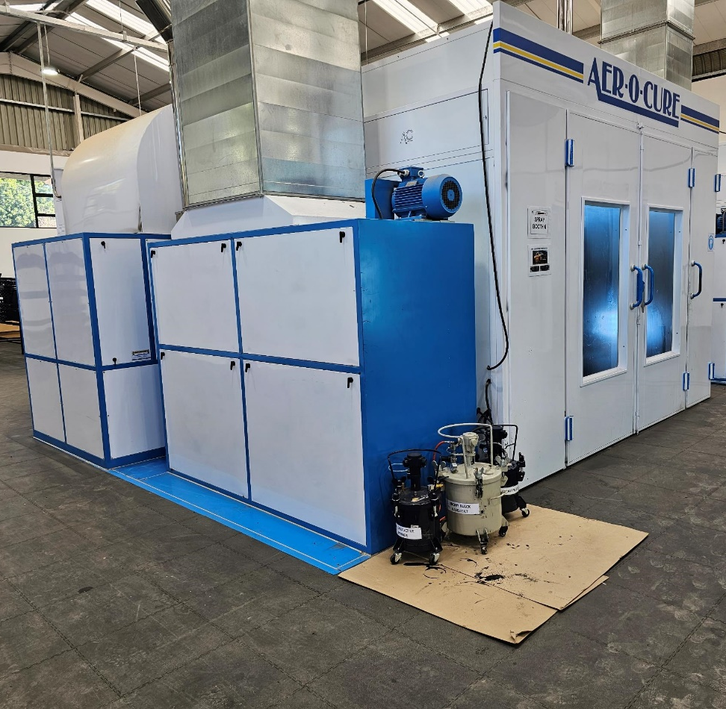
Our Spray Paint Operation
Operation
Spray Paint Booth
Spray paint frames to Ebony Black, Asphalt Black and Bolder Grey

Slide 15
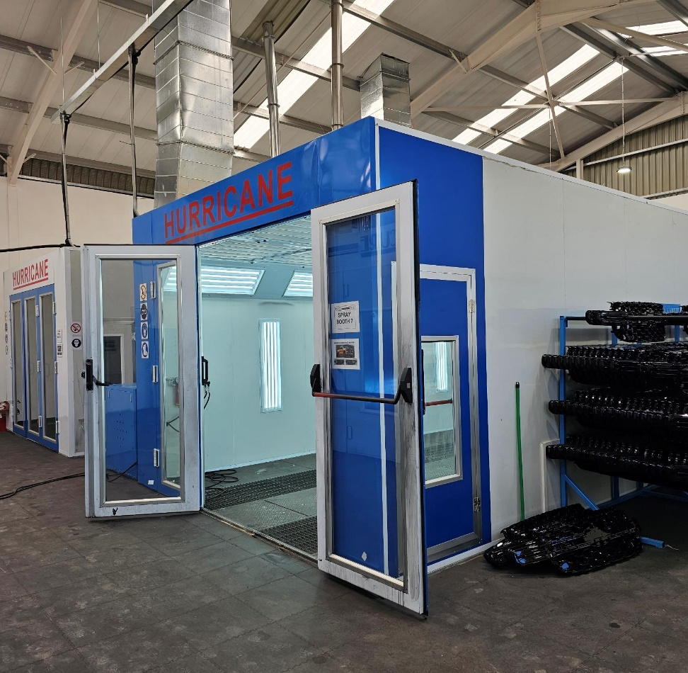
Our Spray Paint Operation
Operation
Spray booth – Baking Oven
Bake painted frames per cycle.
Leave to cure as per customer requirement.

Slide 16
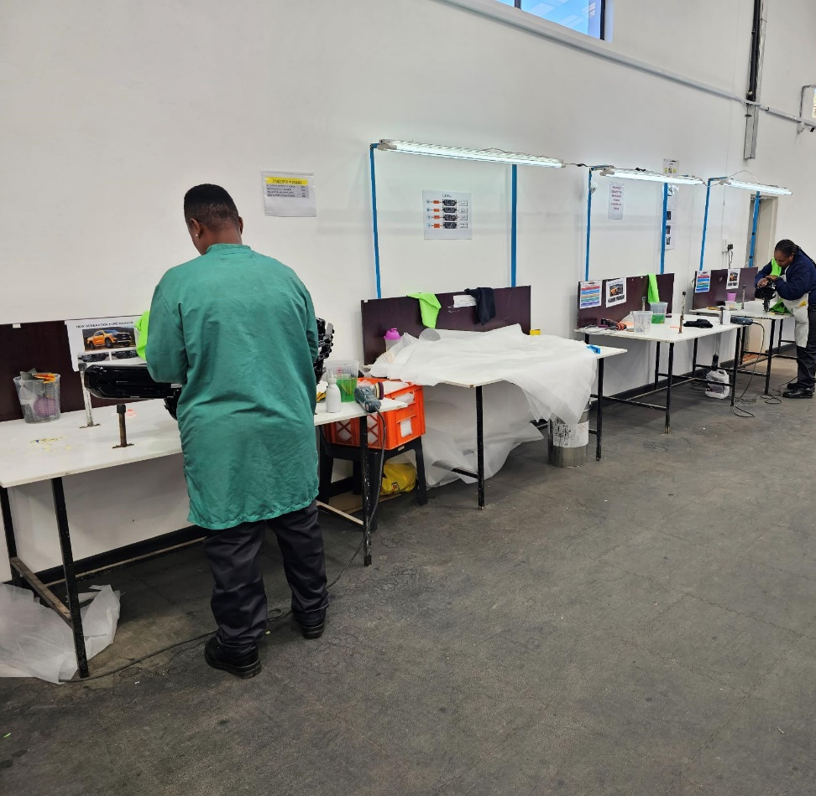
Our Spray Paint Operation
Operation
Polishing Station
Remove dirt and fiber for a smooth surface finish.

